Slide 1

Truth Tables

Slide 2
Truth Tables
Can be used to help evaluate compound boolean expressions
Create a table with columns for each piece of the expression

Slide 3
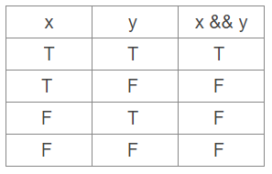
Truth Table : &&
Here is a basic filled in truth table to solve
x && y
This statement is only true when both x and y are true.

Slide 4
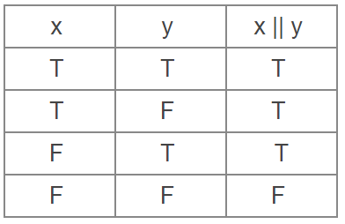
Truth Table : ||
Here is a basic filled in truth table to solve
x || y
This statement is true as long as either x or y is true.

Slide 5
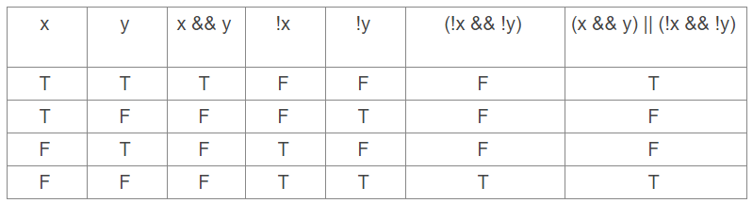
Using Truth Tables
Here is a more complex problem that is broken down into pieces:
Solve (x && y) || (!x && !y)
This is true when either both are true or both are false

